Slide 1
A tale of two acculturations:
How neighborhood foster acculturation and how acculturation change neighborhood
Xiaohui Liuª, Jay Yang^{b}, Marta Jankowska^{b}, Francisco A. Montiel Ishinoª, Quynh C. Nguyen^{c}, Pallavi Dwivedi^{c}, Williams Faustineª.
ª National Institute on Minority Health and Health Disparities, National Institutes of Health, Bethesda, MD
^{b} Qualcomm Institute, University of California San Diego, San Diego, CA
^{c} Department of Epidemiology and Biostatistics, University of Maryland School of Public Health, College Park, MD
Notes:
HI I’m
I work w/ Alex and Faustine on the same CoM dataset.
My topic is

Slide 2

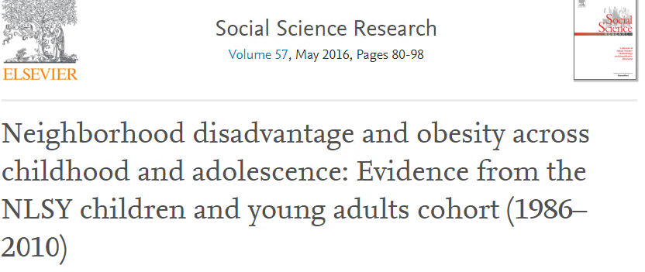

Neighborhood environment & health
health behaviors
chronic conditions
mental health
Notes:
I’ll introduce a little bckg about neighborhood, health, and acculturation research.
The 1st study on health behaviors found that obesity was significantly associated with neighborhood-level factors, particularly the availability of supermarkets and food stores, fitness facilities, percent of commercial land use.
The 2nd study on chronic conditions found neighborhood disadvantage has a strong impact on adolescents' likelihood of becoming obese and contextual influences may increase in strength as they age.
The 3rd study on mental health found that persons living in neighbourhoods with poorer features of the built environment were 29%–58% more likely to report past six month depression and 36%–64% more likely to report lifetime depression than ppl living in neighbourhoods w/ by better features of the built environment.

Slide 3

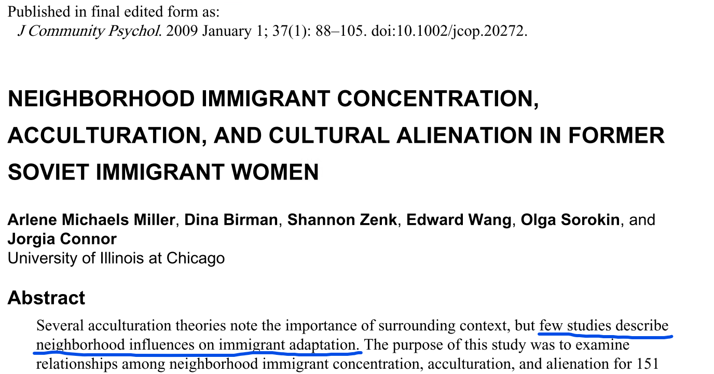
Neighborhood & acculturation
Notes:
Several acculturation studies noted the importance of neighborhood environment, but few studies describe neighborhood influences on acculturation and adaptation of individuals with immigrants history.
The 1st study’s popu consists of Hispanic and Asian young adult of all generation statuses and whites as the comparison group. Results show that an immigrant health advantage is found for first generation Asians. Conversely, a greater likelihood of being obese is found for 2nd, 3rd and higher generation Hispanics compared to third and higher generation Whites. Further, an immigrants enclave work as a buffer against health risks that relate to obesity, particularly in poor neighborhoods.
The second study examined how neigborhood immigrants concentration impacted acculturation among former Soviet immigrant women, and found that the degree of impact depends on neighborhood characteristics. Specifically, no significant relationship between neighborhood Russian immigrant concentration and American acculturation was found, and that largely was due to the fact that most Russian immigrants live in diverse immigrant enclaves as opposed to single immigrant enclave.

Slide 4
Goal:
Examine relationships between neighborhood Hispanic features (business concentration) and acculturation level
Hypothesis:
1) Neighbourhoods with more Hispanic features foster acculturation
2) Acculturation change neighborhood
Hispanic related features
Acculturation level
Notes:
However, our study hopes to test a different perspective, that is, high Hispanics concentration impact their acculturation levels.
Specifically, we used a physical neigborhood lens to examine relationships between neighborhood Hispanic features and acculturation level. Hispanic features include a variety of things related to ppl from Hispanic countries, their culture, and business. I put business concentration here because business signs are most likely to be captured than i.e. cultural symbols.
The 1st hypothesis is Neighbourhoods with more Hispanic culture related features ease the acculturation process and increase acculturation level for two reasons:
1) First, studies show this type of neighbourhood provide an opportunity to be connected to familiar aspects of preimmigration life while developing new ties and identities. 2)It also provides easy access to special foods, ethnic social networks, and other resources that contribute to immigrants’ positive mental health through shared culture and language.
The 2nd hypothesis is that ppl of high acculturation level are more inclined & capable of changing their neighborhood to incorporate more home culture related features
Based on the two hypothesis, our conceptual framework is shown here, and it means more Hisp related features lead to higher acculturation level, and high acculturation level lead to more Hisp related features

Slide 5
Method: Datasets
1. Google Street View (GSV) images
N = 1,132,336
Geography: San Diego county, CA
Exact where: street intersections of all U.S. road types (latitude and longitude)
Street view directions: west, east, north and south for each street intersections
Data collect time: 2017- 2018
2. Community of Mine study
N = 250 (Hispanic, aged 18-80)
Geography: San Diego county, CA
Time: 2014-2017
Variable: U.S. identity, Native Culture identity, English Language proficiency, Native Language proficiency
Notes:
This study used two datasets.
The 1st is Google SV images, of 1.13 million, took within SD county, CA. For the exact location of each image, that is the street intersections of all U.S. road types, and their lat and lon were used to extract the images from Google.
For each location, images were took at 4 directions (WESN) , and betw 2017-18
The 2nd is CoM survey data, which has 250 Hispanic participants that are beween age 18 & 80, also in SD county, between 2014-17. The specific variables we use to represent the acculturation levels are …

Slide 6
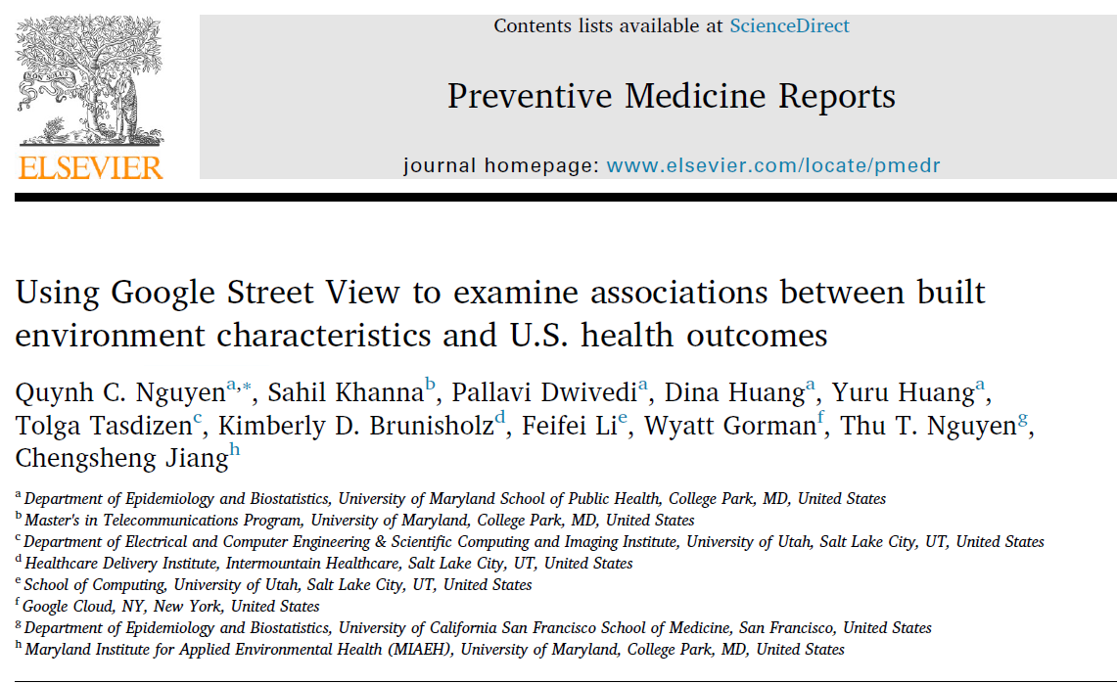
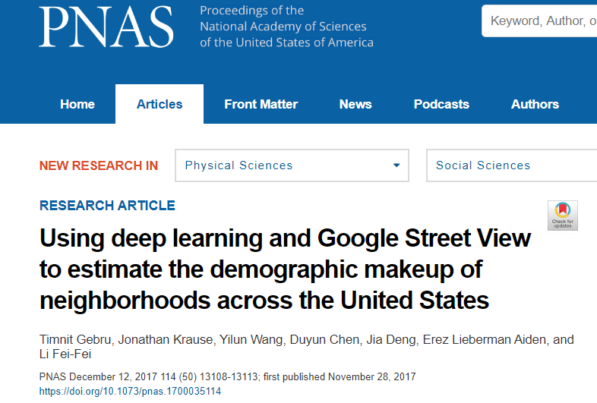
Dataset: Google Street View (GSV)
Notes:
One of the reasons for using GSV was that this dataset is very new, and there are only a few publications used it to study physical neighborhood.
The paper on the left was led by Dr. Nguyen at UMD, who shared their GSV with us. They studied the association of build env features and U.S. health outcomes. Their findings suggest areas characterized by street view images as ‘rural’ (having limited infrastructure) had higher obesity, diabetes, fair/poor self-rated health, premature mortality, physical distress, physical inactivity and teen birth rates but lower rates of excessive drinking.
The paper on the right was done by the Google computer vision team to estimate demographic make up of neighborhood across U.S based on GSV using machine learning. Using 50 million GSV images of 200 cities, the study determined the make, model, can year of all motor vehicles in the image, and then accurately estimated income race, education, and voting patterns at zip code and precinct level.

Slide 7
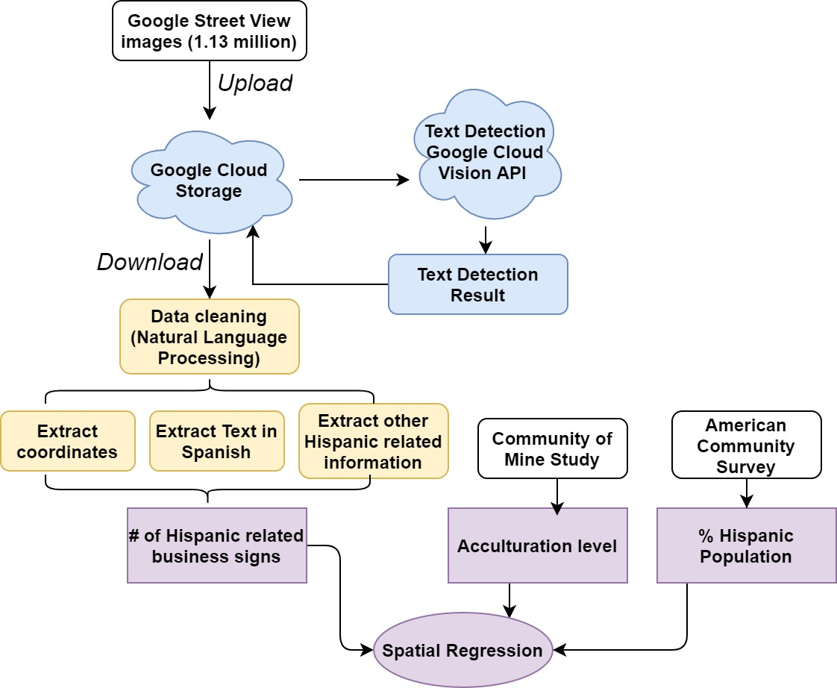
Workflow
Notes:
Taking all of this, let’s go over the workflow.
The 1st step is image text detection on G cloud. The 1.1 m GSV were first uploaded to GCS, then G Cloud Vision API used its pretrained machine learning models to detect text on the images. The detected text were then sent back to GCS before I downloaded it.
The next step is data cleaning using Natural LP, where I extracted the coordinates, text in Spanish, and other Hispanic related info from English text. To extract text in Spanish, I searched the language label of “es”, which stands for Esponol,. For other Hispanic related info, I used a set of keywords, including country names, restaurant names, common Spanish shopping words, etc. If you are interested in the list of used keywords, I have put them in the appendix.
After these steps, I was able to find the # of Hispanic related business signs and put them on map, which I’ll show you in a second.
Moreover, I also have the % of Hispanic pop data from ACS. As of now, the work within the dashed circle has been done.
census

Slide 8
Hispanic related text
Text in Spanish (“es”)
Text in English, contains words related to below categories:
“Mexico”, ”Mexican”, etc.
Common Hispanic restaurant names
Hispanic store/shop names
Hispanic shopping vocabularies
Notes:
To extract text in Spanish, I searched the language label of “es”, which stands for Esponol,.
For other Hispanic related info, I used a set of keywords, including country names, restaurant names, common Spanish shopping words, etc. If you are interested in the list of used keywords, I can show you later.

Slide 9
Workflow
Notes:
After these steps, I was able to find the # of Hispanic related business signs and put them on map, which I’ll show you in a second.
Moreover, I also have the % of Hispanic pop data from ACS.
As of now, the work within the dashed circles has finished, and we are waiting for the geolocation of the CoM survey participants to link all the three together to do spatial regression.

Slide 10
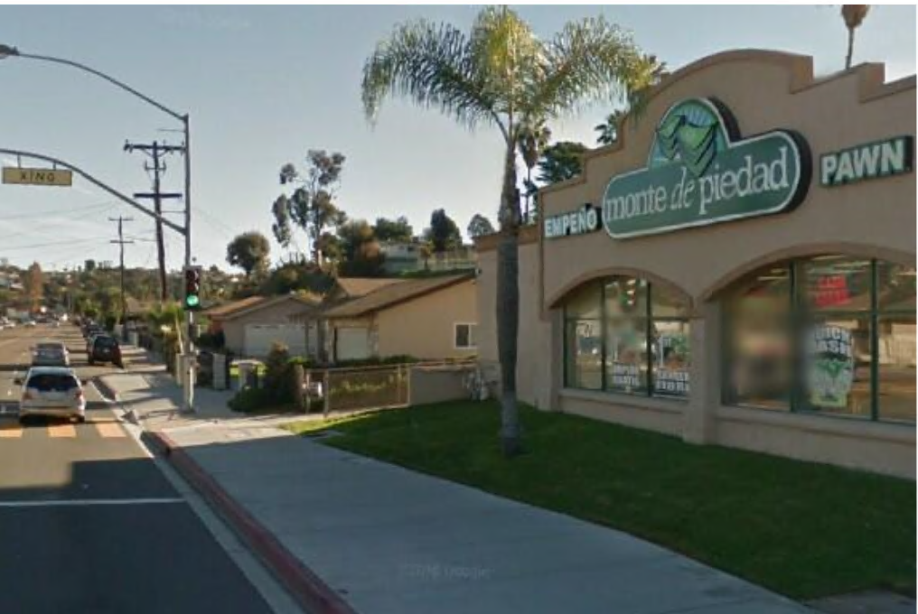
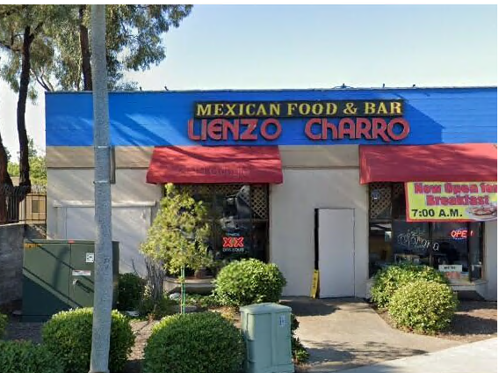
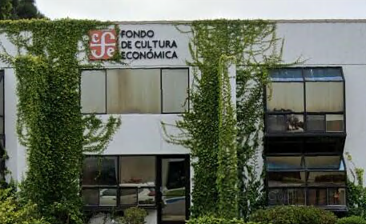
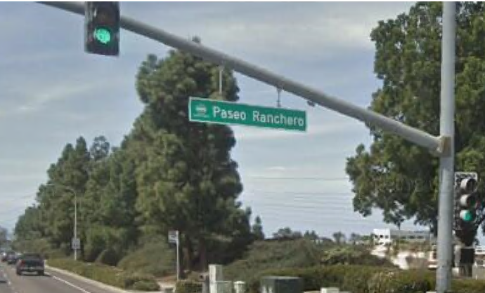
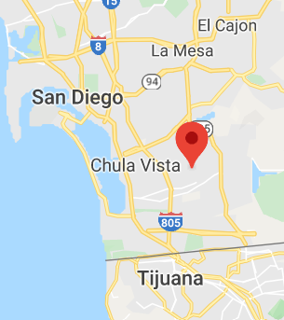
GSV w/ Hispanic related business/road signs in Spanish
Notes:
There are some egs of the GSV images with Hispanic related business/road signs in Spanish. The two image on the left are financial business, the one on the upper right is a food place, the lower right is a road sign.
A side note, the location of the img on the lower right corner is very close to the US Mexico border.

Slide 11
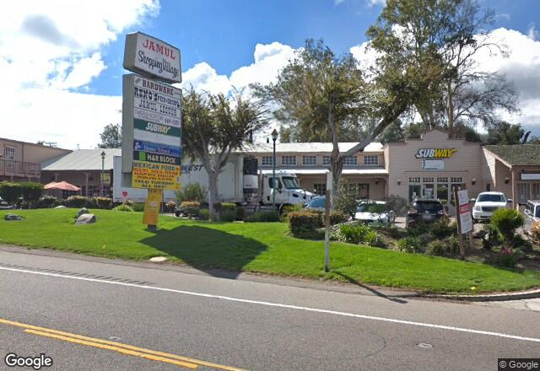
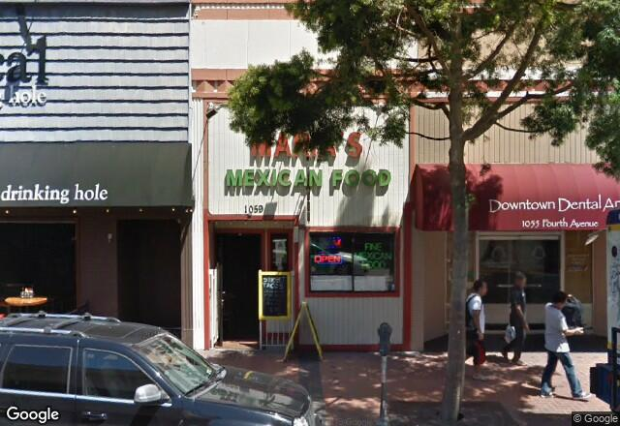
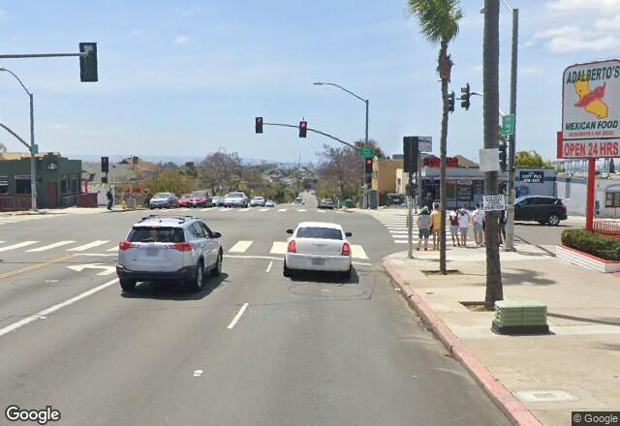
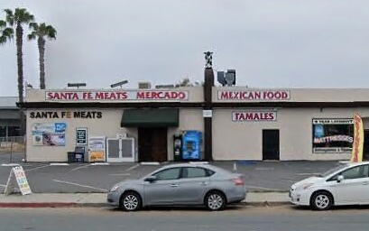
GSV w/ Hispanic related business signs in English
Notes:
A few more images with English text. All imgs have Mexican food on their business signs.

Slide 12
Result
 | # | %
Google Street View Images | 1,132,336 | 100.0%
Images with text | 66,188 | 5.85%
Images with text in Spanish language | 323 | 0.029%
Images contain Hispanic related features (i.e., “Mexico”, etc.) in English language | 84 | 0.007%
Hispanic related | 407 | 0.036%
Notes:
There is the summary of the # of images. Among the 1.1 m imgs, around 6% contains text. Within the 6%, img in Spanish takes .029% of all images, and img contains Hispanic related features in English takes .007% of all.
Overall, there are 407 Hispanic related imgs, and takes .036% of all images

Slide 13
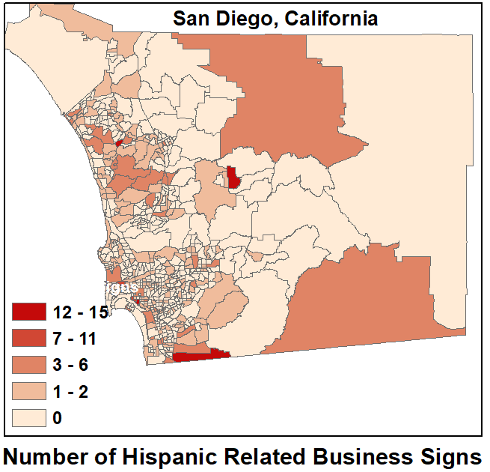
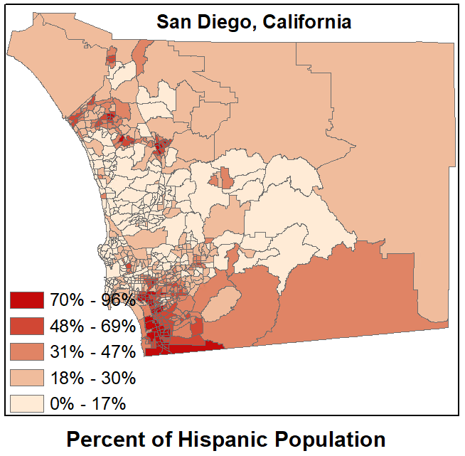
Notes:
The map on the left shows the # of Hispanic related business signs, and map on the right shows the % of Hispanic pop on census tract level.
I want to point out a few things as you compare these two maps.
First, the census tract bordered by Mexico has from 70 to 96% of Hisp pop, and our study also found the most amount of Hisp related business signs in this tract.
2nd, this tiny tract on the north west side of county w/ has the most amount of Hispanic related business signs, similarly, high concentration of hisp population is also present on the right map.
Further, those inland tracts have the least amount of Hisp related business signs and also have very low % of Hisp pop.
Given this, we can say the # of Hisp related business signs correlate with % of Hisp pop in some census tracts, even though not in all of them.

Slide 14
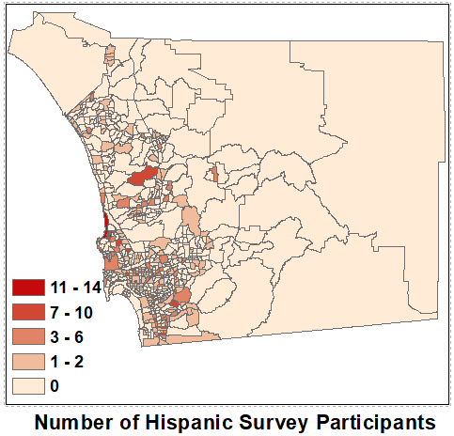
Hispanic related business signs
Notes:
The map on the left is again the % of pop in each census tract, the right map shows where the participants were recruited from in CoM study.
By comparing the maps, I realized that the Hisp CoM survey participants were not necessarily from denser Hispanic communities, but were rather evenly distributed in tracts closer to coastline. This strengthened our choice of % Hisp pop as a control variable in upcoming spatial regression analysis.

Slide 15
Next step
Association of acculturation level and physical neighborhood features -- Spatial regression
DV: CoM participants’ acculturation level
The geolocation will link acculturation to GSV result
IV (covariates): # of Hispanic related business signs
Control Variable: % Hispanic population
Hispanic related features
Acculturation level
Notes:
We are waiting for exact residential address of CoM survey participants from our coauthor. With participants’ locations, we could link their acculturation levels to the result from GSV images. From there, we’ll do spatial regression.
DV will be CoM participants’ acculturation level, which consist of US identiy, Native identiy, English language proficiency, native language proficiency.
IV will be # of Hispanic related business signs, and we also use % Latino population as the control variable.
With this model, we can test the association of Hispnic related features and acculturation level.

Slide 16

Q & A

Slide 17
Strength
GSV images
Allow assessment of built environment features
Provide most recent neighborhood data
Less expensive and time consuming
Text detection using computer vision and cloud computing
Provide industry leading accuracy to understand massive images
Google cloud platform allow efficient processing time
3. Spatially link acculturation level with physical neighborhood features

Slide 18
Limitation
1. Dataset:
GSV images were downloaded at intersections of all US road types, where there is lower chance of capturing business signs that are less likely to be located at intersections
2. Technique
Google Vision API less effective detecting text on GSV images which were taken at far distance
Errors in detecting language types, i.e., labeled “fy” as “en”, labeled “cn” as “en”

Slide 19
Common Mexican restaurant names
El Ranchero
Macho
Las Tapas
The Tasty Quesadilla
Bigotes y Sombreros
La Placa Caliente
Tequila N' Taquitos
Macho Tacos
El Ranchero
Las Tapas
La Haba Burrito
El Ranchero Baile
La Sangria Sabroso
El Burrito Haba
¡Olé, Olé, Olé!
Los Amigos Restaurante
The Enchilada Man
Restaurante de Mexico
Three Amigos
Margaritas
La Familia Restaurante
Hot Tamales
Burrito Country
Mis Amigos Restaurante
Enchiladas
Nacho Queso
Su Vecindario Restaurante
Uno, Dos, Tequila
Tiempo de Salsa
Mas Tequila
Beans N' Rice
Picante's
Frijoles Picante
Carmelitas
Sombreros
Nachos Crujiente

Slide 20
Spanish store/shop names
aguardentería
azucarería
bizcochería
boletería
cafetería
calcetería
carnicería
charcutería
cervecería
confitería
droguería
ebanistería
ferretería
floristería
frutería
heladería
herboristería
herrería
joyería
juguetería
lavandería
lechería
lencería
librería
mueblería
panadería
papelería
pastelería
peluquería
perfumería
pescadería
pizzería
platería
pulpería
ropavejería
salchicheria
sastrería
sombrerería
tabaquería
tapicería
tintorería
verdulería
zapatería

Slide 21
Hispanic shopping vocabularies
abierto — open
cajero — cashier
cerrado — closed
descuento, rebaja — discount
empuje — push (on a door)
entrada — entrance
jale — pull (on a door)
oferta — sale
precios bajos — low prices
tienda — store or shop

